Slide 1
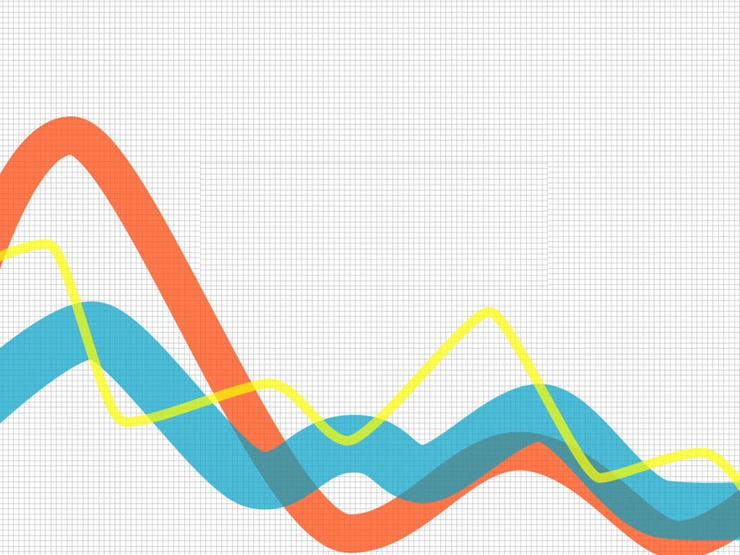
ARIMA MODEL
3458 – SHIVAM SHARMA

Slide 2
INTRODUCTION
ARIMA is an acronym that stands for Autoregressive Integrated Moving Average.
The ARIMA model has been used for analyzing time series data to predict future value
ARIMA models are applied in the cases where the data shows evidence of non-stationary

Slide 3
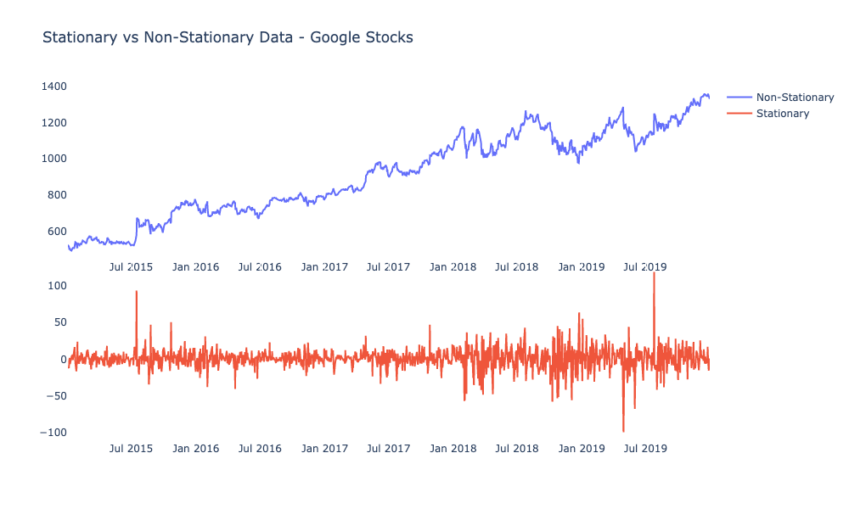
Stationary & Non-Stationary

Slide 4
Component ( AR – I – MA )
AR (p)
AutoRegressive model , indicating that the model uses the dependent relationship between current data and its past values.
I
(d)
Integrated The use of differencing of raw observations
(e.g. Subtracting an observation from an observation at the previous time step) in order to make the time series stationary.
MA
(q)
Moving Average model indicating that the forecast or outcome of the model depends linearly on the past values.

Slide 5
Parameters of the ARIMA (p, d, q)
p
the number of autoregressive terms or the number of “lag observations.” determines the order of differencing
q
the number of forecast errors in the model
d
the degree of differencing. it indicates the number of times the lagged indicators have been subtracted to make the data stationary.

Slide 6
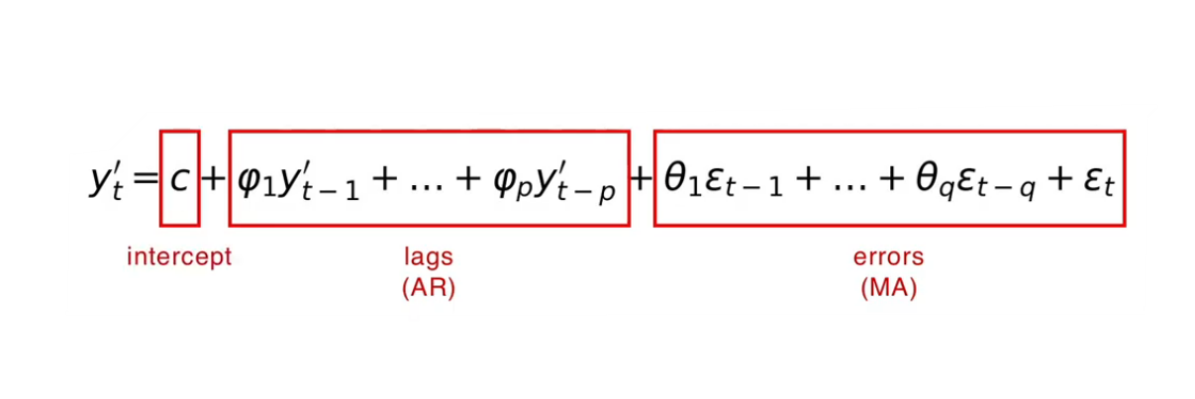
ARIMA Model (Formula)
https://colab.research.google.com/drive/1myiIAmkTWc5NI_4Q7B64K3O4uvqKTDch#scrollTo=EiF6UNuVMVXU

Slide 7
IMPLEMENTATION
ARIMA

Slide 8
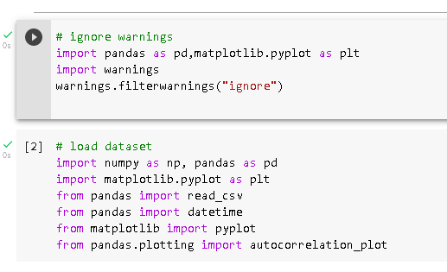
IMPORTING LIBRARY

Slide 9
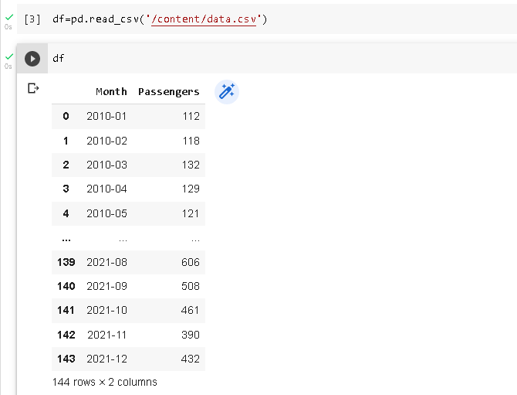
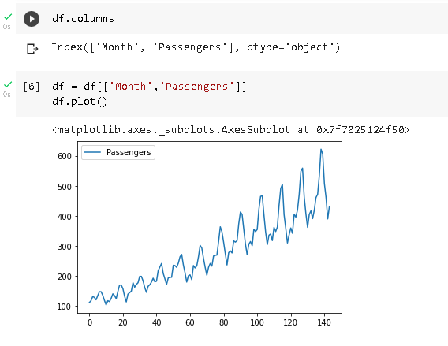

Data Loading

Slide 10
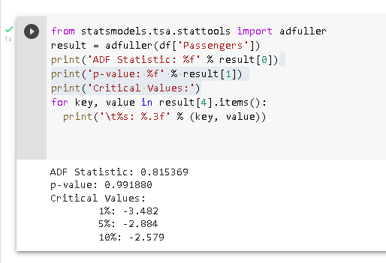
Checking Stationary in Data

Slide 11
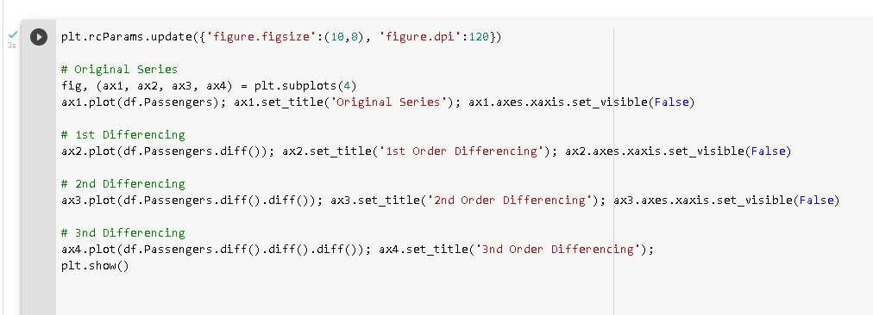


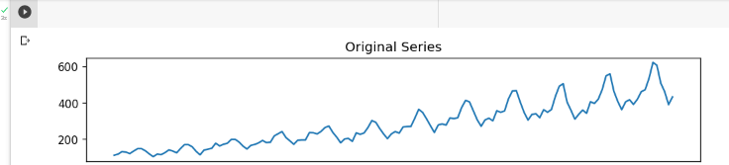
Finding the value of the d parameter

Slide 12
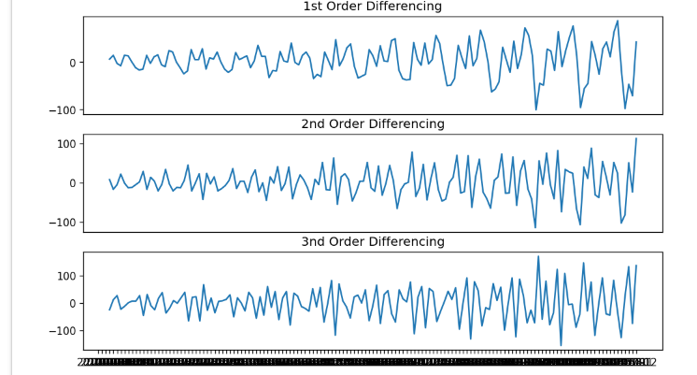

Slide 13
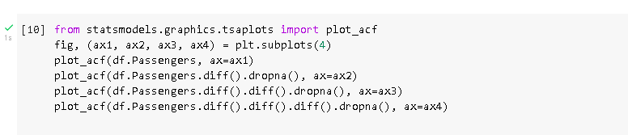

Slide 14
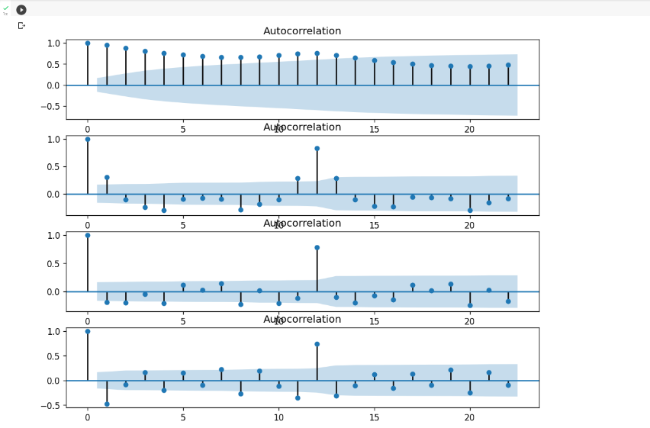

Slide 15
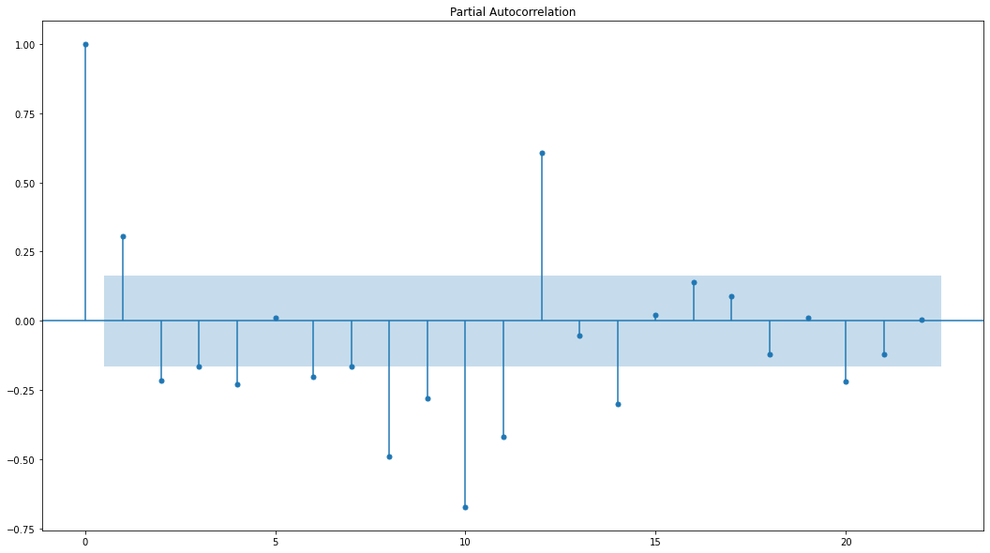
Finding the value of the ’’p’’ parameter

Slide 16

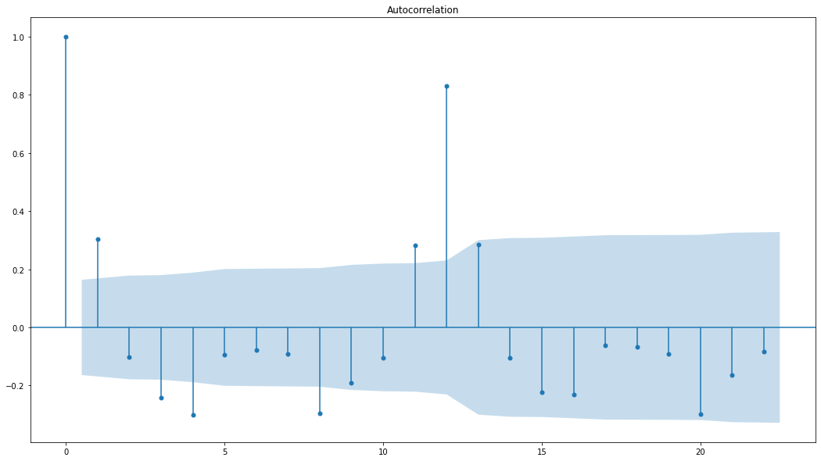
Finding the value of the ’’q’’ parameter

Slide 17
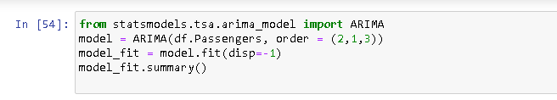
Implementation Of ARIMA(p,d,q)

Slide 18
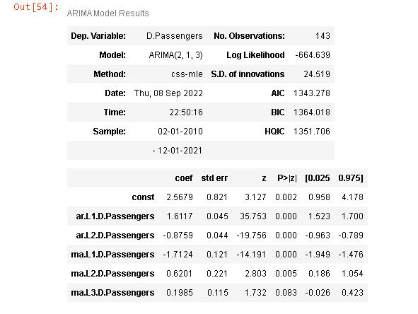
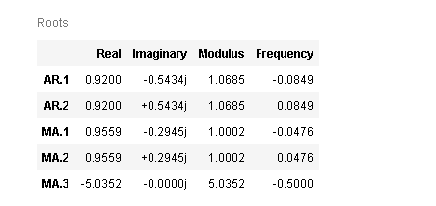

Slide 19
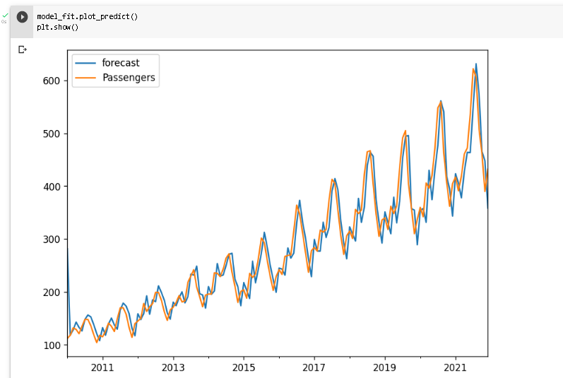

Slide 20


